Slide 1
Pizza Sales Analysis

Slide 2

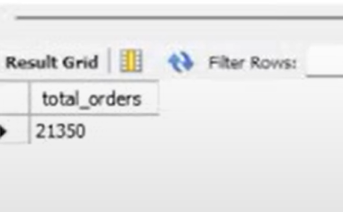
Retrieve the total number of orders placed.

Slide 3

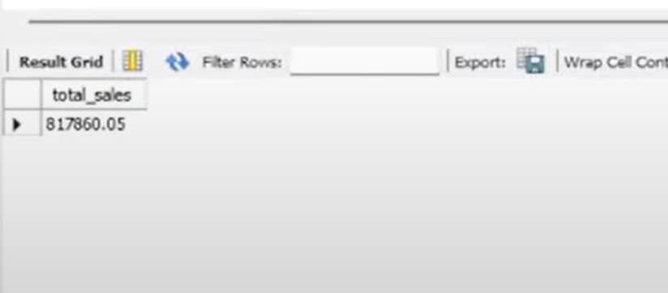
Calculate the total revenue generated from pizza sales.

Slide 4


Identify the highest-priced pizza.

